Slide 1




News Analysis
Team Members
Salma Mohamed Abdelfatah ID: 21100795
Ahmed Mohamed Dawood ID:21100820
Mohamed Talaat Elsalmawy ID:21100809
Ahmed Mohamed Elmohamady ID:21100821
George Nashaat Mosaed ID:21100825

Slide 2

Introduction
In today's fast-paced digital world, the volume of news content produced each day is overwhelming. News articles come from multiple sources, covering various topics and opinions. It is crucial for individuals and organizations to understand the underlying sentiment of this news—whether positive, negative, or neutral. This project aims to develop a machine learning-based solution to classify the sentiment of news articles, providing a faster and more objective analysis of media tone.

Slide 3


Problem Statement
The sheer quantity of news being generated makes it impractical for people to manually analyze the sentiment of each article. Traditional sentiment analysis methods are time-consuming and prone to human bias. This project addresses these limitations by developing an automated system that classifies the sentiment of news articles, delivering quick and objective insights. By focusing on natural language processing (NLP) techniques, particularly using a fine-tuned BERT model, the system classifies news into positive, negative, and neutral categories. This makes sentiment analysis more scalable, accurate, and reliable.

Slide 4
Methodology
1- Data Selection
For this project, merged two datasets:
1- Sentiment Analysis for Financial News Dataset: This dataset includes financial news articles labeled for sentiment analysis. The dataset contains two columns, Sentiment and News Headline, has 4846 news. The sentiment can be negative, neutral or positive.
2- IMDB Movie Reviews Dataset: This dataset has two column review and sentiment. contains 50,000 reviews from IMDB, labeled as either positive or negative. It is widely used for binary sentiment classification tasks.
Final Merged Dataset: After merging the selected rows from the IMDB dataset with the financial news dataset, the final dataset comprised 27,000 news Text.

Slide 5


2- Preprocessing
In natural language processing (NLP), preprocessing is a critical step that prepares raw text data for machine learning models. This phase ensures that the text is clean, standardized, and ready for efficient analysis. The preprocessing techniques applied in this project include:
01
02
04
05
06
03
Removing stop words
Stemming words using the Porter Stemmer
Removing HTML tags
Removing Punctuations
Remove Extra White Spaces
Lower Casing

Slide 6
2- Model Selection
(BERT (Bidirectional Encoder Representations from Transformers)
Input Embedding Layer: This layer converts input tokens (words or subwords) into numerical representations called embeddings. Each token gets represented as a vector in a high-dimensional space.
Transformer Encoder Layers: BERT uses a stack of transformer encoder layers. Each transformer encoder layer has two sub-layers:
Self-Attention Mechanism: This sub-layer computes the importance of each word in the context of the whole sentence. It helps BERT understand the relationships between different words.
Feedforward Neural Network: After self-attention, each word's representation passes through a feedforward neural network, allowing BERT to capture complex patterns in the data.
Output Layers: At the top of the model, there are output layers that process the final representations produced by the transformer layers. These layers are task-specific and can vary depending on the downstream task BERT is being used for. For example, in text classification tasks, there might be a softmax layer for classification.

Slide 7
3- Model Development
Tokenization
BERT (Bidirectional Encoder Representations from Transformers) uses its own tokenizer because of the specific tokenization strategy it employs, which is called WordPiece tokenization. This tokenization method breaks down words into smaller subword units, allowing BERT to handle out-of-vocabulary words and capture more fine-grained information about word morphology and context.
text: Input text data to be tokenized, converted to a list of strings.
2. add_special_tokens: Adds special tokens required by BERT (e.g., [CLS] and [SEP]).
3. return_tensors: Returns TensorFlow tensors after tokenization.
4. max_length: Maximum length of tokenized sequences; longer sequences are truncated, shorter ones padded.
5. padding: Enables padding of sequences to match the maximum length.
6. truncation: Enables truncation of sequences longer than the maximum length.
- max_len=40 specifies that the maximum length of tokenized sequences should be 40 tokens, ensuring uniformity for processing in neural networks.

Slide 8
3- Model Development
input_ids:
Purpose: This layer represents the tokenized input sequences, where each token is represented by its corresponding integer index.
Functionality: It provides the actual input data to the BERT model. Each integer index corresponds to a token in the input text, following the tokenization process. These tokenized sequences are fed into the model for processing.
attention_mask:
Purpose: This layer represents the attention mask, which indicates to the model which tokens should be attended to and which should be ignored during processing.
Functionality: The attention mask allows the model to focus on relevant tokens and disregard padding tokens. It has the same length as the input sequences and consists of 1s and 0s, where 1 indicates that the token should be attended to, and 0 indicates that the token should be ignored.

Slide 9
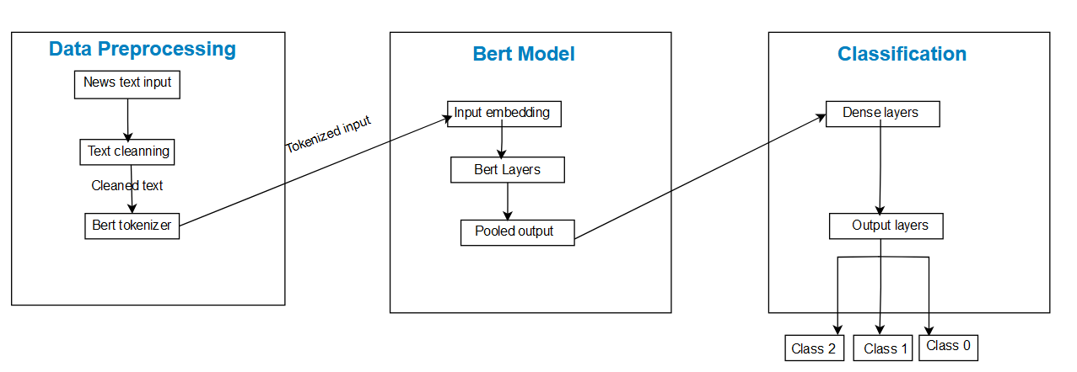
3- Model Development
1. BERT Embeddings:
- Extracts embeddings from the BERT model for input tokenized sequences using `bert_model`.
- Global max pooling condenses embeddings into a fixed-length vector.
2. Dense Layers:
- Stacks fully connected layers with ReLU activation: 128 units, 64 units, and 32 units.
- Dropout regularization (50%) applied between layers to prevent overfitting.
3. Output Layer:
- Final layer with 3 units (softmax activation) for multi-class classification.
Model architecture

Slide 10

4-Model Training
Adam Optimizer: Used for its efficiency in handling sparse gradients, the Adam optimizer dynamically adjusts the learning rate. A learning rate of 2e-5 was chosen to balance training speed and stability, while Epsilon (1e-8) helped avoid numerical issues during gradient updates. Clipnorm (1.0) capped the gradients to prevent instability from large updates.
Batch Size (32): Balanced between training speed and memory consumption, allowing the model to process multiple samples simultaneously.
Early Stopping: Applied to halt training when validation performance stopped improving, helping prevent overfitting by monitoring the validation loss.
Categorical Crossentropy: This loss function was used to optimize multi-class classification, ensuring accurate predictions across the positive, negative, and neutral sentiment categories.
Training Duration: The model was trained over 10 epochs with continuous validation to track its performance, leveraging early stopping to maintain generalization.

Slide 11
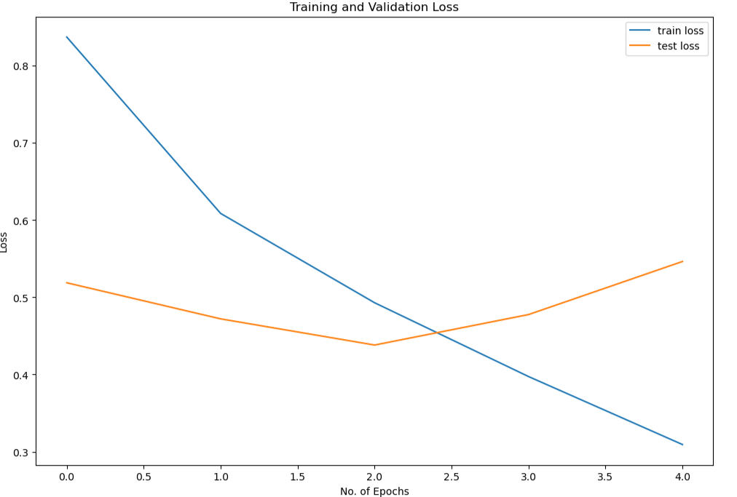
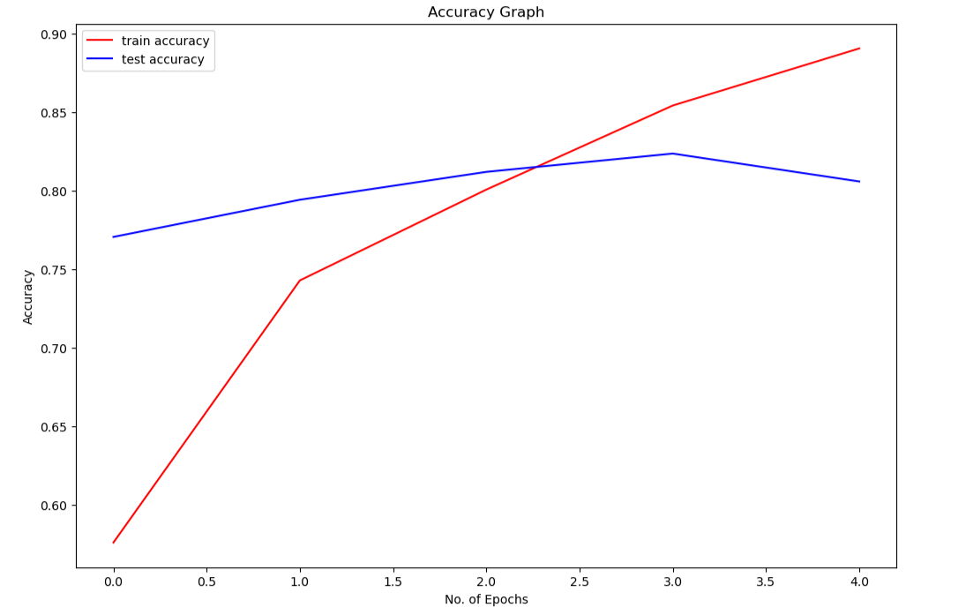
5- Model Evaluation
(1) Training and Validation Loss:
The training loss showed a steady decrease over epochs, indicating that the model was learning and fitting well to the training data.
The validation loss initially decreased but began to increase after epoch 4, signaling potential overfitting. The best validation accuracy was achieved at epoch 3 (accuracy of 81.2%).
(2) Test Performance:
The final evaluation on the test set resulted in a categorical cross-entropy loss of 0.546 and a categorical accuracy of 80.6%.
The confusion matrix revealed that the model correctly predicted the majority of class 0 and class 2 samples but had some misclassification between classes 0 and 2.

Slide 12
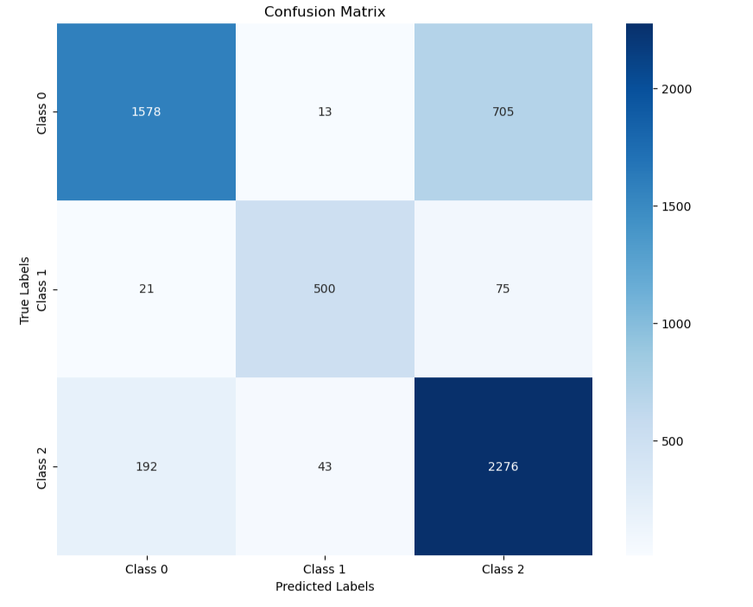
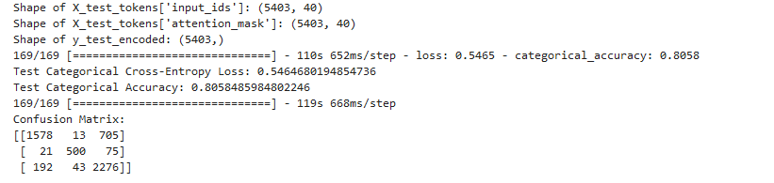
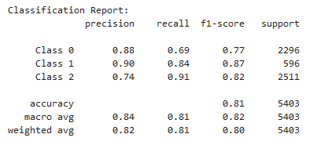
5- Model Evaluation
( (3) Precision, Recall, and F1-Score:
Class 0 (Negative): Precision of 88%, recall of 69%, and an F1-score of 77%, showing good precision but some difficulties in recall.
Class 1 (Neutral): Precision of 90%, recall of 84%, and F1-score of 87%, indicating strong performance on the neutral class.
Class 2 (Positive): Precision of 74%, recall of 91%, and F1-score of 82%, reflecting high recall but lower precision compared to other classes.

Slide 13
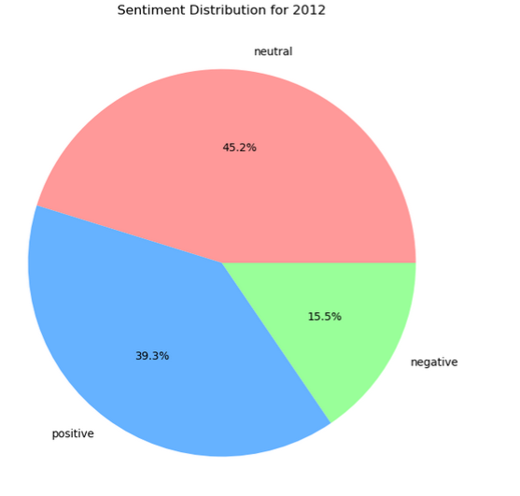
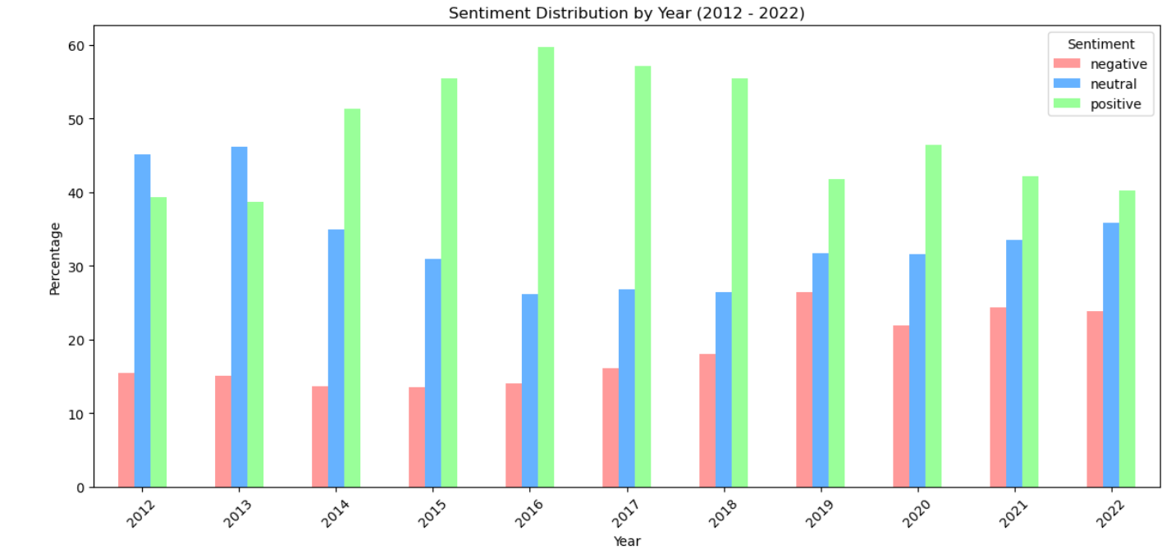
5- Visualization
Applied the sentiment analysis model to the News_Category Dataset_v3.json (dataset), analyzing the distribution of each sentiment (positive, negative, neutral) across various news categories. We conducted an in-depth analysis to determine the proportion of each sentiment in the dataset, providing insights into how sentiments are distributed in different types of news articles from 2012 to 2022. The results were visualized using pie charts to clearly represent the sentiment breakdown across this period.

Slide 14


Conclusion
This project successfully developed a sentiment analysis model using state-of-the-art NLP techniques, particularly BERT, to classify news articles as positive, negative, or neutral. By leveraging a combination of the Sentiment Analysis for Financial News dataset and IMDB Movie Reviews, we created a robust model that achieves high accuracy in predicting sentiment. The project demonstrated the effectiveness of advanced preprocessing methods, efficient model training with fine-tuned hyperparameters, and insightful visualizations of sentiment trends over a decade (2012-2022).

